Slide 1
DS&AI Project Reasoning about actions, change, events and time
Marcello Bonsangue
LIACS – Leiden University
m.m.bonsangue@liacs.leidenuniv.nl
Reusing slides from Jacques Robin

Slide 2
Outline
Non-monotonic reasoning
When and where to reason about actions, change, event and time?
Reasoning services
Roadmap of approach

Slide 3
Non-monotonic reasoning (recall)
Classical logic reasoning is monotonic
If KB |= f, then ∀g, KB ∧ g |= f
Inference engine only performs ask and tell the KB, never retract
Non-monotonic reasoning
Allows KB |= f, and then KB ∧ g |≠ f
Previously derived facts can be retracted upon arrival (for example from sensors) of new, conflicting evidence

Slide 4
Two orthogonal sources of non-monotonicity
Ontological: in non-stationary environment E
KB must reflect environment changes as time goes by
when fact f true in E(t) no longer true in E(t+1)
unless KB uses a historically cumulative knowledge representation scheme
sentence s in KB(t) that represents f must retracted from KB(t+1).
and so must all sentences in KB(t) proven using s! (truth-maintenance)

Slide 5
Two orthogonal sources of non-monotonicity
Epistemological: in partially observable environment E
Decision making with partial knowledge requires using abduction in addition to deduction
KB must reflect changes of the agent’s beliefs as new evidence becomes available through sensing
KB(t) = D(t) ∪ A(t,H(t)), where
D(t) are sentences derived purely deductively from percept sequence and KB(0)
A(t,H(t)) are sentences derived using at least one abductive step relying on some hypothesis in H(t)
When ¬a ∈ D(t) and a ∈ A(t-1,H(t-1)) , a must be retracted from KB(t)
and so must all sentences in A(t-1,H(t-1)) derived using a!

Slide 6
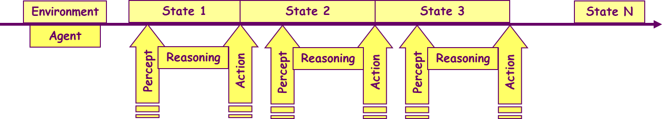
When to reason about actions, change, events and time?
Non-stationary environments
Sequential (only actions and change)

Slide 7
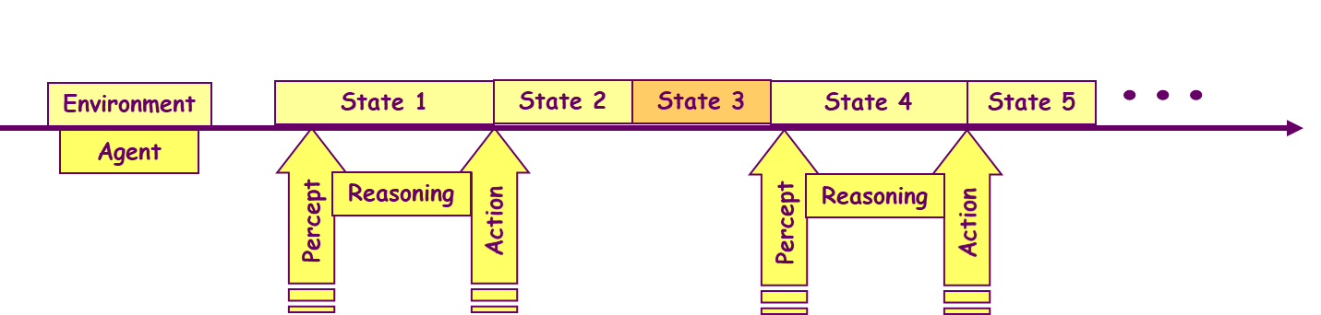
When to reason about actions, change, events and time?
Non-stationary environments
Concurrent synchronous (actions, change and events)

Slide 8
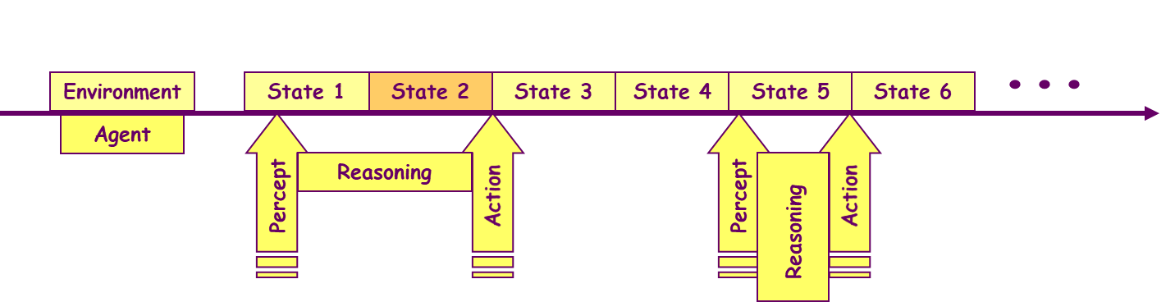
When to reason about actions, change, events and time?
Non-stationary environments
Concurrent asynchronous (actions, change, events and time)

Slide 9
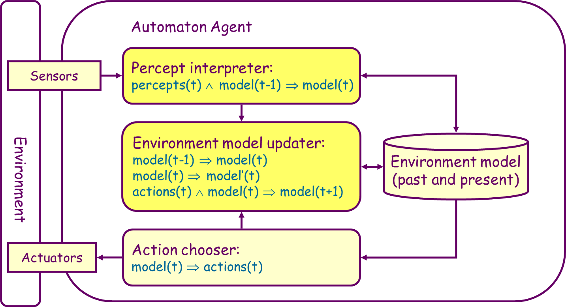
When to reason about actions, change, events and time?

Slide 10
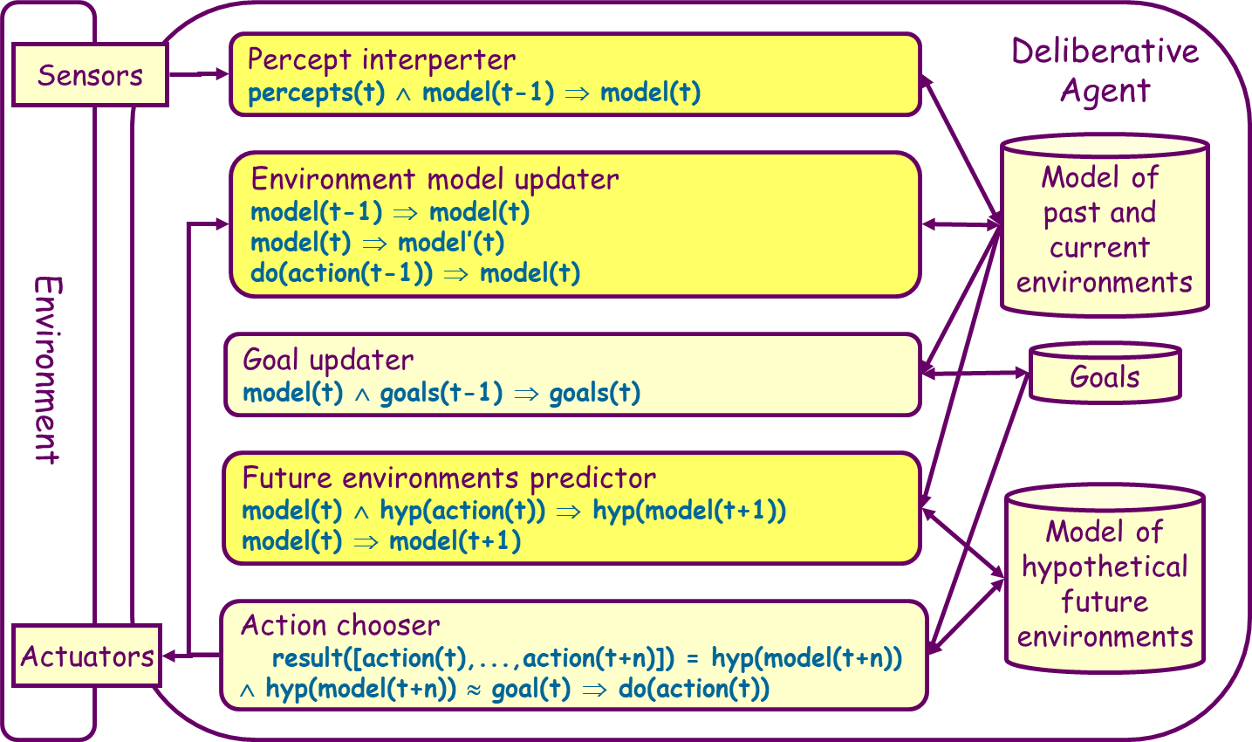
When to reason about actions, change, events and time?

Slide 11
Reasoning services 1
For all services: environment model decomposed in:
Eternals: properties and relations not affected by actions, events or the passing of time
Fluents: properties and relations that change as result of the execution of an action, the occurrence of an event or the passing of time
Single action (event) consequence:
Given current environment state model
Compute fluents resulting from the execution (occurrence) of a single action (event)

Slide 12
Reasoning services 2
Temporal projection:
Given current environment state model
and a sequence of hypothetical actions to execute and events to occur
Compute fluents of the resulting environment state
Planning:
Given current environment model
and a set of goal fluents
Compute action sequence whose execution will turn these goal fluents true

Slide 13
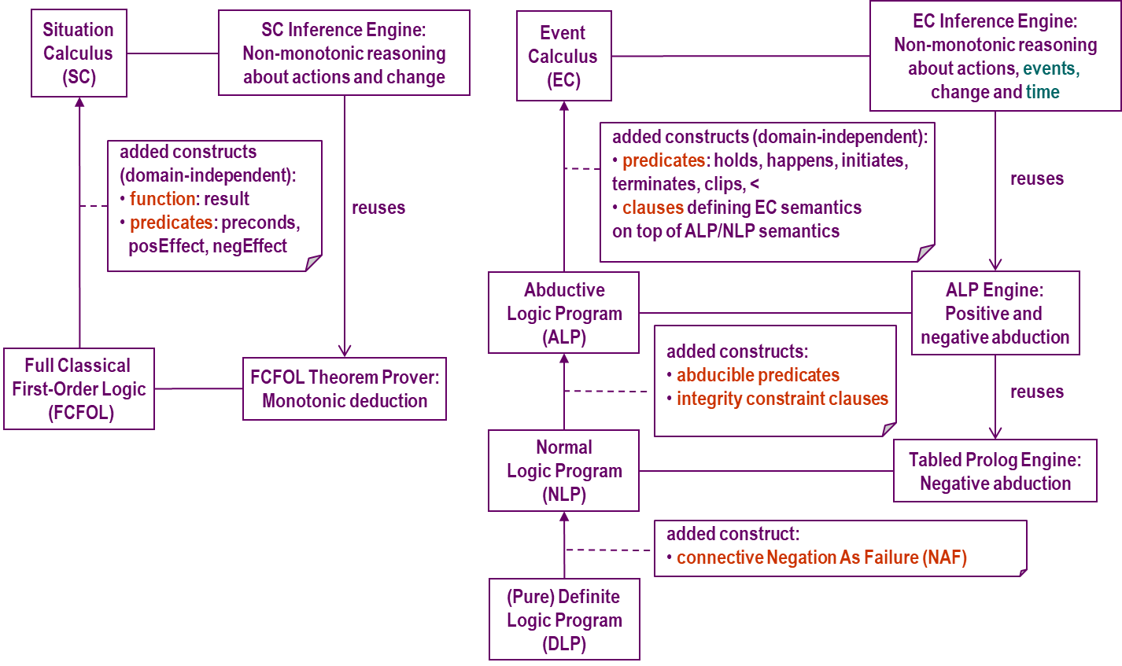
Roadmap next lessons: situation and event calculi

Slide 14
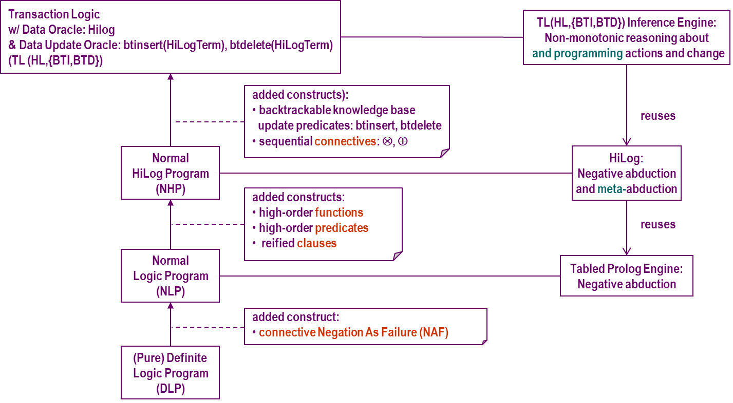
Roadmap next lessons: transaction logic

